Slide 1
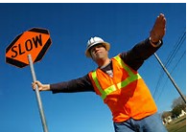

SIGNALING AND FLAGGING
Train and Test

Slide 2
SIGNALING ACCORDING TO OSHA
Flagmen
When operations are such that signs, signals, and barricades do not provide the necessary protection on or adjacent to a highway or street, flagmen or other appropriate traffic controls shall be provided.
Signaling directions by flagmen shall conform to American National Standards Institute D6.1-1971, Manual on Uniform Traffic Control Devices for Streets and Highways.

Slide 3
SIGNALING CONTINUED
Hand signaling by flagmen shall be by use of red flags at least 18 inches square or sign paddles, and in periods of darkness, red lights.
Flagmen shall be provided with and shall wear a red or orange warning garment while flagging. Warning garments worn at night shall be of reflectorized material.
For daytime work, the flagger's vest, shirt, or jacket shall be orange, yellow, strong yellow green or fluorescent versions of these colors. For nighttime work, similar outside garments shall be retro reflective. The retro reflective material shall be orange, yellow, white, silver, strong yellow-green, or a fluorescent version of one of these colors and shall be visible at a minimum distance of 1,000 feet.

Slide 4
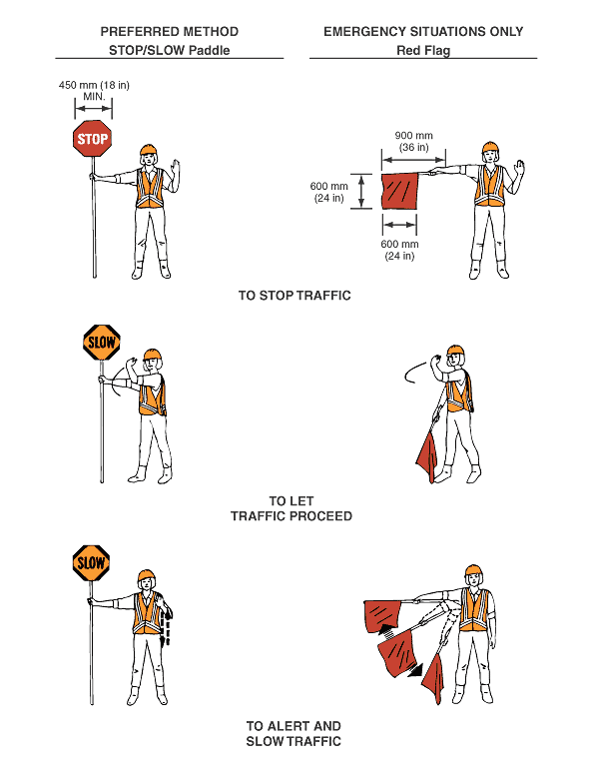
SIGNALING CONTINUED
1926.201
Flaggers
  When signs, signals, and barricades do not provide necessary protection on or adjacent to a highway or street, then flaggers shall be provided
  Shall conform to part VI of the Manual of Uniform Traffic Control Devices

Slide 5
SINGALING CONTINUED
You are a “defensive flagger,” and, as such, you have a very important job.
Your job, your responsibility, is to
Protect the lives of workers,
Guide traffic safely past the work area,
Protect yourself.
To do these things, you must communicate with motorists. To communicate with motorists and control traffic, you must understand exactly:
What is expected of you, and
What the traffic control setup is.
Whenever you have a question, refer to your company plan or guideline.

Slide 6
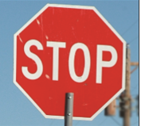
SIGNALING CONTINUED
Basic flagger equipment is the STOP/SLOW paddle and the flag. At times, you may need a two-way radio to communicate with another flagger at the other end of the work area, and an air horn to alert workers to emergencies.
Two sizes of STOP/SLOW paddles are used:
The smaller size is 18 by 18 inches
The larger size is 24 by 24 inches and should be used when the roadway posted speed is 45 miles per hour or greater. It can be seen and recognized my motorists sooner.
For your safety, and the protection of motorists and fellow workers, you must use the proper hand signals when using STOP/SLOW paddle.

Slide 7
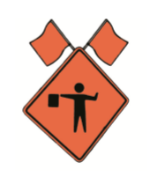
SIGNALING CONTINUED
Advance warning signs tell motorists what to expect on the roadway and give them time to respond. Except in emergency situations, flagger stations must be preceded by an advance warning sign or signs.
These warning signs are routinely used for flagging operations:
ROAD WORK AHEAD
ONE LANE ROAD AHEAD
BE PREPARED TO STOP
FLAGGER (shown to the right)

Slide 8
TAKE THE TEST AND
THANK YOU!
Control/Click on URL below.
Sign in by entering your first and last name
Enter password “CHRISTELTRAIN1” IN ALL CAPS.
Take the QUIZ – You will need 70% to pass
Results will be reported against and published as they occur
https://testmoz.com/1261839

Slide 9
End of quiz
We invite you to move to the next module as time allows. Safety is as important to us as you and your families are. Let’s do this together!

